Slide 1
Creative Arts – Visual Art
Year 9 and 10

Slide 2
What do you do?
Make Drawings, Paintings, Prints and Sculptures.
Refine skills and techniques learnt in Year 8 Art.
Appreciate Art made by people from different cultures and historical periods.
Generate your own original ideas and images.
Present and Exhibit your work.

Slide 3
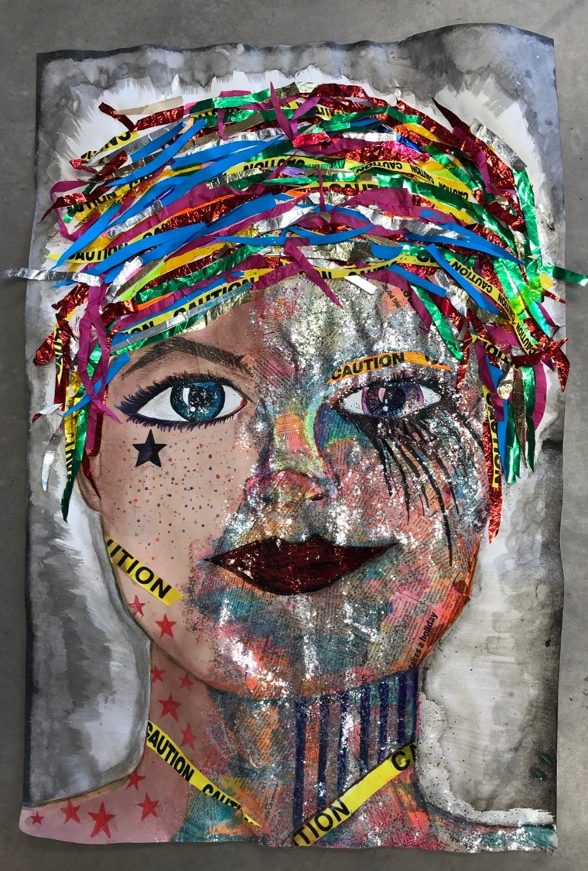
What do you do?
For assessment you will be required to submit a portfolio of finished artworks, a sketchbook detailing idea generation and written responses to art and culture.

Slide 4
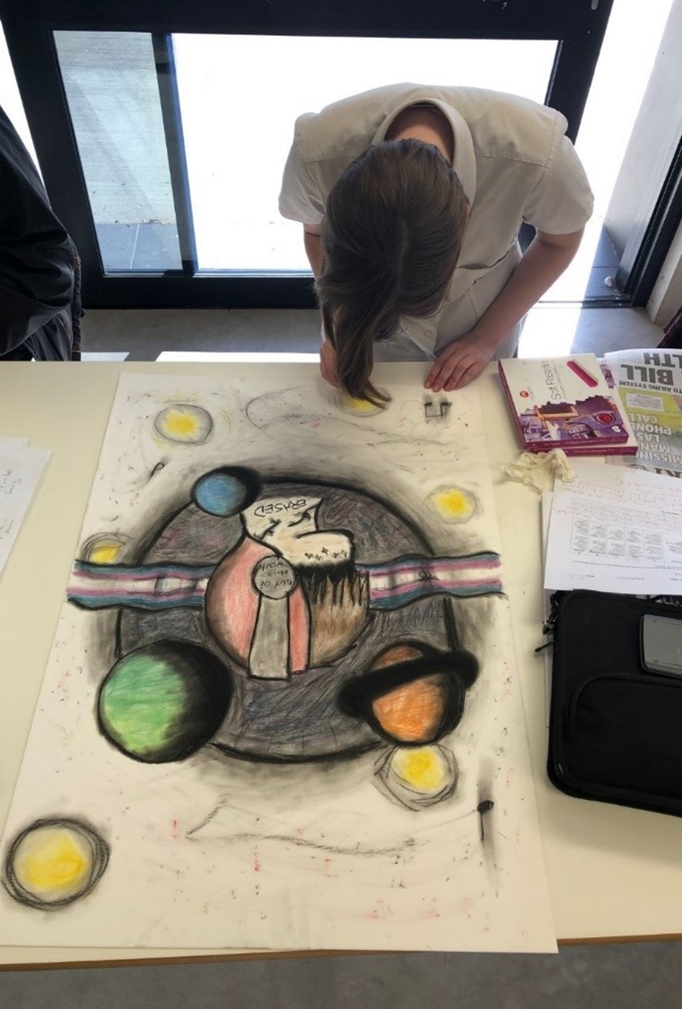
What you need?
The ability to work independently.
A willingness to try new things.
A desire to make things.

Slide 5
Find out more…
Please feel free to contact Mr Mike O’Brien, Head of Creative Arts, at mobrien@dominic.tas.edu.au

